Slide 1
DATA MINING
MAXIMIZE CASH FLOW THROUGH RENTAL PROPERTIES IN SAN DIEGO
ANISHA AGARWAL
ARSHIA SALI
JEENA THAMPI
POOJA PRASANNAN

Slide 2
WHAT ARE THE BENEFITS OF INVESTING IN REAL ESTATE?
1. Great Returns
As the real estate you own increases in value over time, you can sell it for a solid profit.
2. Diversification
Adding real estate to your investments boosts your diversification, which can protect you in times of economic turmoil. Say certain stocks are suffering because of an economic downturn. The investment properties in your portfolio might still be increasing in value, protecting you from the losses your other investments are taking.
3. Protection Against Inflation
Real estate investments are considered to offer protection against inflation. When the prices of goods and services are rising, home values and rents typically increase, too. Investment properties, then, can provide you with rising monthly income and appreciation to help protect you financially when the costs of everything else is going up, too.
4. Tax Advantages
Investing in real estate comes with tax benefits. You can deduct several expenses associated with owning an investment property, including your property taxes, mortgage interest, property management fees, property insurance, the costs of ongoing maintenance, the cost of repairs and the money you pay to market your property to potential renters. If you sell your property for more than you paid for it, the gain you realized won't be taxed as income. Instead, it will be taxed as capital gains, which typically come with lower tax rates than does income.

Slide 3
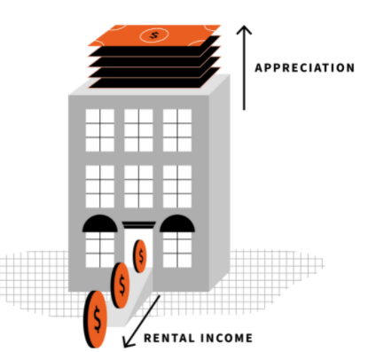
HOW DO RENTAL PROPERTIES HELP US EARN MONEY?
Real estate can earn money over the short term and long term through income as well as appreciation.
Value Appreciation
The value of real estate properties appreciates with time. This means as the price of the property goes up over time, you will earn more and will be able to pay your mortgage quickly.
Recurring Cash Flow
Rental properties generate recurring income meaning you won't have to put out too much effort to maintain it. It can be an excellent way to ensure financial security before you retire, or just have extra money in the bank.

Slide 4
THINGS TO KNOW BEFORE RENTAL INVESTMENT
Neighborhood -The neighborhood in which you buy will determine the types of tenants you attract and your vacancy rate.
Schools - Consider the quality of the local schools. The overall value of your rental property comes into play when you eventually sell it. If there are no good schools nearby, it can affect the value of your investment.
Crime - No one wants to live next door to a hot spot of criminal activity. You can check about the frequency of a police presence in your neighborhood.
Average Rents - Make sure any property you consider can bear enough rent to cover your mortgage payment, taxes, and other expenses.

Slide 5
CRISP-DM
What is CRISP-DM?
The CRoss Industry Standard Process for Data Mining (CRISP-DM) is a process model with six phases that naturally describes the data science life cycle. It’s like a set of guardrails to help you plan, organize, and implement your data science project.
Business understanding – What does the business need?
Data understanding – What data do we have / need? Is it clean?
Data preparation – How do we organize the data for modeling?
Modeling – What modeling techniques should we apply?
Evaluation – Which model best meets the business objectives?
Deployment – How do stakeholders access the results?

Slide 6
OBJECTIVE OF THIS PROJECT
1. BUSINESS UNDERSTANDING
An investor couldn't be more happier if he/she gets the combination below 5 data, which could be profitable, affordable and safe.
The objective of this project is to find such combination. Below are the given data which are directly related to the objective. We are trying to find such data, amalgamate them, do some analysis, prediction and provide the accuracy to the data which we have formed.
Good investment = Rent Estimate - Monthly Mortgage(HOA, Property Taxes, upkeep) > 0

Slide 7
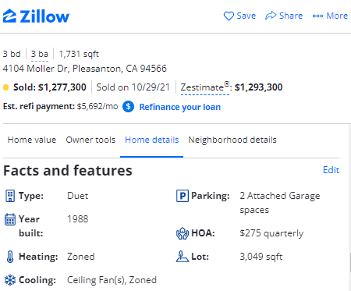
DATA SOURCE
1I. DATA UNDERSTANDING
1. Zillow (Web Scraping)
Zillow is the leading real estate and rental marketplace dedicated to empowering consumers with data, inspiration and knowledge around a place.
Zillow serves the full lifecycle of owning and living in a home: buying, selling, renting, financing, remodeling and more.
It starts with Zillow's living database of more than 110 million U.S. homes - including homes for sale, homes for rent and homes not currently on the market, as well as Zestimate home values, Rent Zestimate, HOA, Amenities and other home-related information.

Slide 8
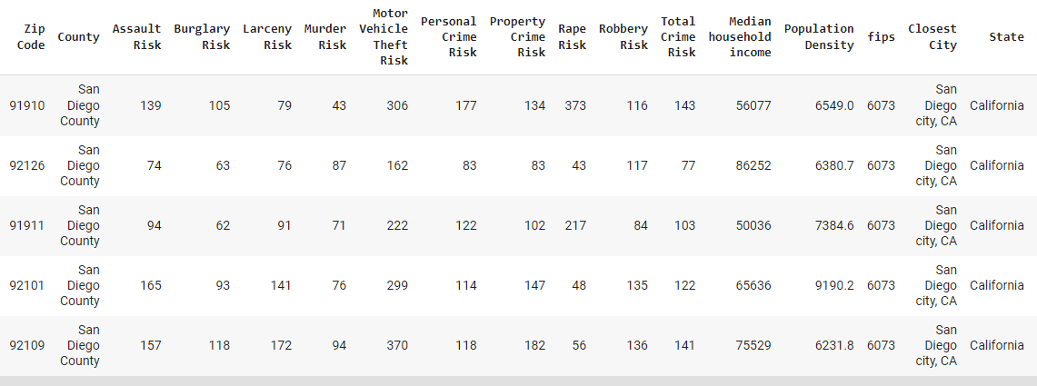
DATA SOURCE (CRIME DATA)
Publicly available datasource: https://github.com/crfranch/San-Diego-Housing-Market/blob/master/crimes_merge_all.csv
It consists multiple type of risks like robbery, rape, burglary, assualt, murder etc.
A total crime risk attribute is also available which is useful.
Median Household income is other important attribute of this dataset

Slide 9
1I. DATA PREPARATION
Data amalgamation of multiple datasets.
Checking for duplicates, Null values and Data types.
Fetching San Diego dataset from US Housing dataset, using the ID of this dataset to scrape it from Zillow website. Then using the Zipcode of each data and fetching the crime data for that particluar zipcode.
Filled out the null values from its mean calculation.
Removed the unnecessary Columns and rows.
PCA dimensionality reduction is been performed by selecting the required features.

Slide 10
III. MODELING
Defined the training and test data by splitting the dataset
Fractal clustering to determine the better investment property
Used elbow method and silhouette score to determine effective number of clusters
Performed multiple iterations to get the golden cluster having profitable investment properties
Trained the model using the following classifiers and regressors:
KNN Classifier, Logistic Regressor, Gradient Boost Classifier, Random Forest, MLP classifier, Decision Tree, KNN, Gradient Boost, MLP, Random Forest, Linear Regressor
Plotted confusion matrix
Found latent variables and added those to enhance the model

Slide 11
APPROACH
From Multiple Datasets, we are trying to get the best features which can actually have a large impact on buying/investing in houses.
Like,
For calculating Mortgage value we need 30 year fixed interest rate, which we have taken from 2nd dataset.
For Property Tax price calculation, we need property tax rate, which we have taken from 2nd dataset.
For an accurate calculation of Good investment we also need HOA, which we have taken from 2nd dataset.
Adding Crime rate data, definitely enhanced the dataset, added from 3rd dataset.
Added Average Income from 3rd dataset
Latent Variable = having the best combination above 5 data, which could be profitable, affordable and safe.

Slide 12
DEMONSTRATION OF THE COLAB

Slide 13
IV. EVALUATION
Observations from Fractal Clustering
Basis of Finding golden cluster
rent amount - monthly mortgage amount -home owner association fees (HOA) = profit > 0
rent_zestimate > monthly_mortgage
Found golden cluster in the third iteration.
Observations from training the model
Accuracy
 | Dataset 1 | Dataset 2 | After adding latent variables
Classifier | 80% | 89% | 90%
Regressor | 56% | 67% | 69%

Slide 14
V. DEPLOYMENT
Deployment can be done using Amazon SageMaker. This helps to build and train models quickly which can then be deployed into a production ready environment.
First we’ll spin up the notebook instance which will host the jupyter notebook.
Upload the data to S3 bucket.
Train the model. During training SageMaker finds the data from S3.
Deploy the model to Amazon EC2
Then we can evaluate the model.

Slide 15
CONCLUSION
Using fractal clustering, we got more fine grained results which is more accurate than increasing the overall number of clusters initially.
we were able to find out the most profitable investment properties in San Diego through the Zillow dataset.
Also, feature importance helped us a lot in using the important features and reducing noise, for this we leveraged gini scores, correlation matrix, PCA and shapley values.
We could increase the accuracy of our model by enriching the data using amalgamation.

Slide 16
Thank you!!!

